Slide 1

Backend Process of Blockchain Technology
Project Work in C
INTRODUCTION
Developer : Utkarsh Shukla
Undergraduate Student
RGIPT

Slide 2
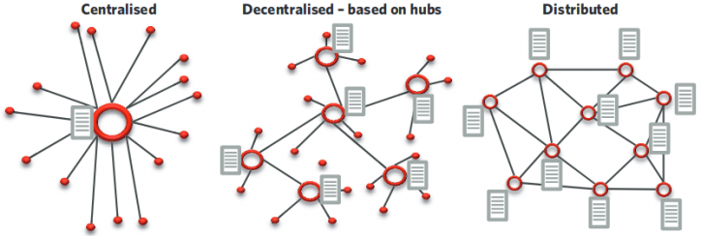
What is Blockchain?
Blockchain is a distributed
decentralized immutable ledger that is
very useful for security purpose .

Slide 3


Our project is based on
The use of blockchain
in health care

Slide 4

Theme : A firm wants to use Blockchain
Based health-care platform for
The validation of patient ’ Id ,
Name , test data and status. We want
to show the backend process that
Are going to use for this .
In this project , We used various concept of
C programming ,as : file handling , looping,
Linked list , switch statement , break statement.
I also access crypto library to use SHA function.
This Photo by Unknown Author is licensed under CC BY-NC

Slide 5
What I do?
Develop a blockchain model in C
2. Understand the theoretical concept
Of hashing and role of SHA256.
3. We use Ubuntu for convenience.
4.Understand the backend functionality
of blockchain.

Slide 6
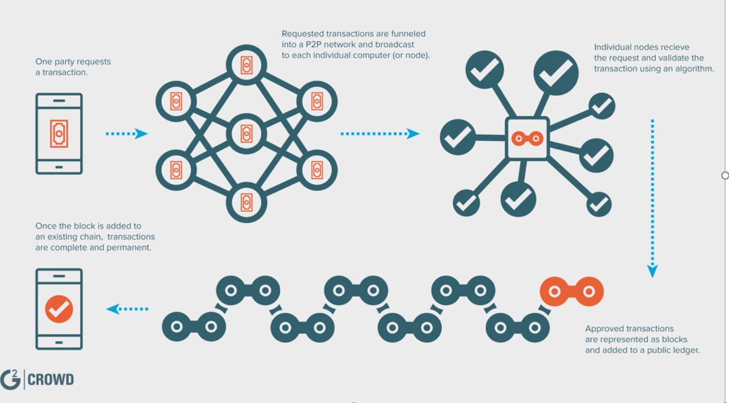
How does Blockchain works?

Slide 7

How WE provide security
Or what’s mean by SHA256?
SHA : Secure Hash Algorithm
SHA 256 is a math process that
generates a 256 bit (64 character long)
random sequence of letters and
numbers (hash) out of any input.

Slide 8
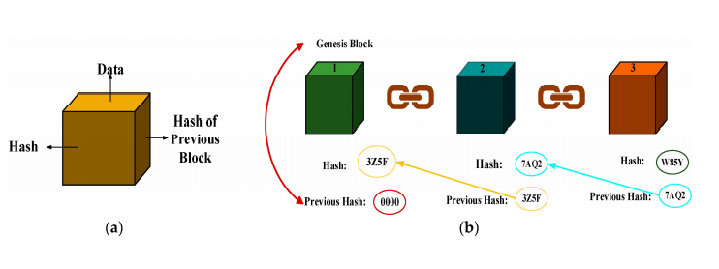
Methodology we are
Going to use in this….
This is use of hashing

Slide 9
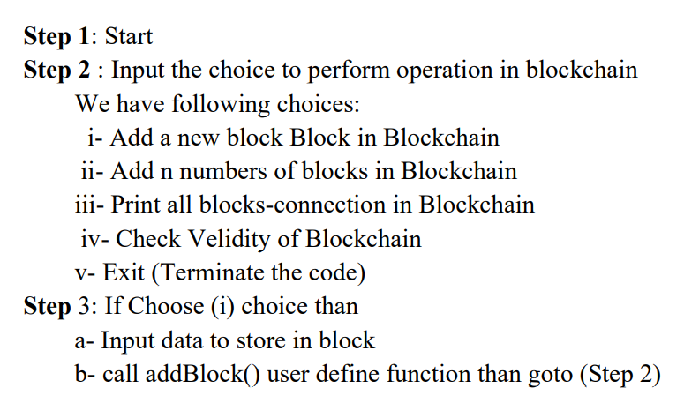
ALGORITHM OF CODE

Slide 10
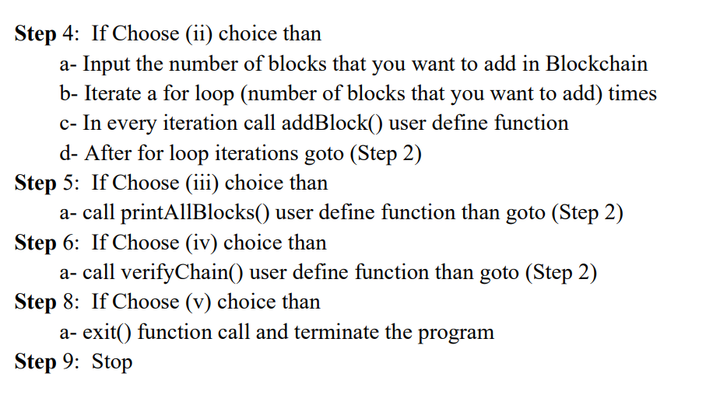

Slide 11
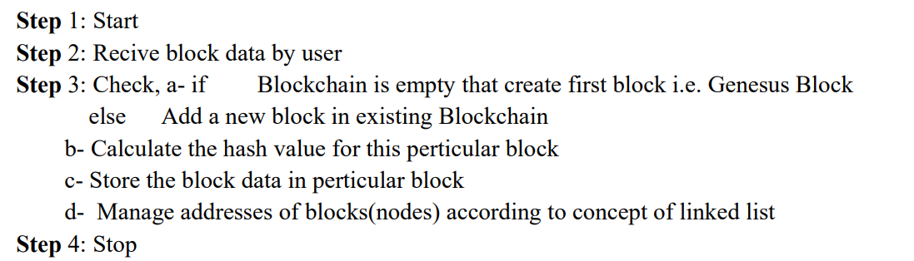
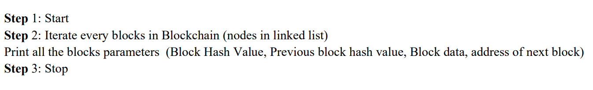
Algorithm for addBlock()
Algorithm for printallBLOCKS()

Slide 12
ALGORITHM FOR VERICATION OF BLOCKCHAIN
Step 1: Start
Step 2: Check , Blockchain is empty or not Step
Step3: if blockchain is empty than print the message "Hey, Blockchain is empty!
Please try after adding some block!“
else print message of velidity " Blockchain is valid !!“
Step 4: Stop

Slide 13
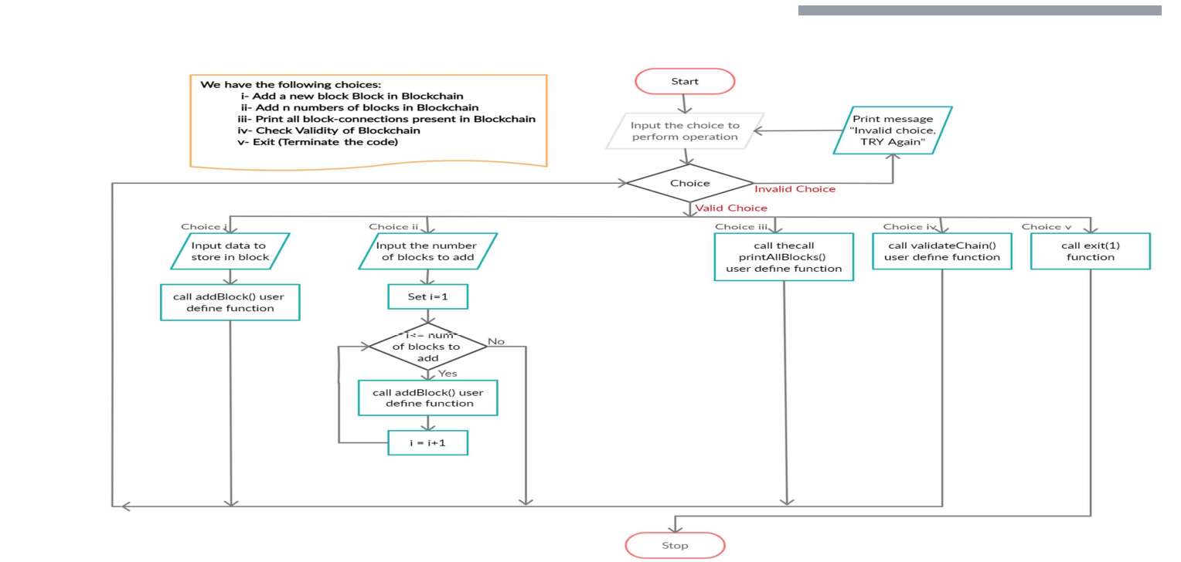
Flowchart for this problem

Slide 14
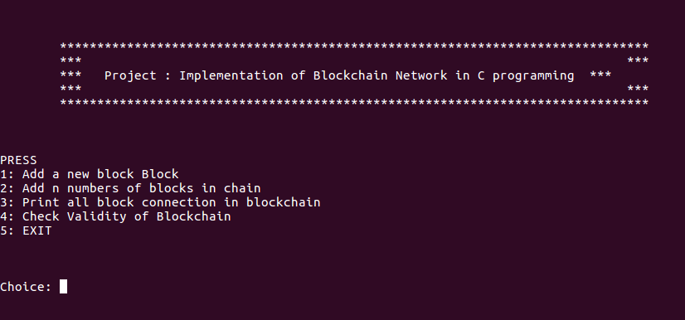
Output we are getting
Here we 5 choices ,
Choose one of them.

Slide 15
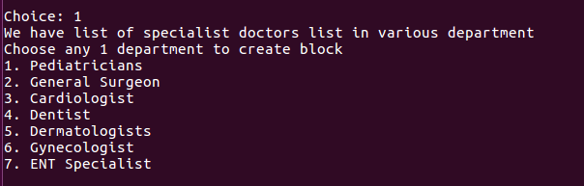
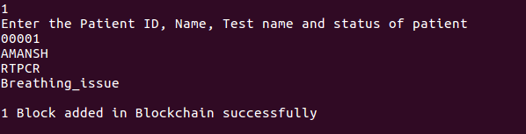
Select one of them.
If I select 1:
Same for others…

Slide 16
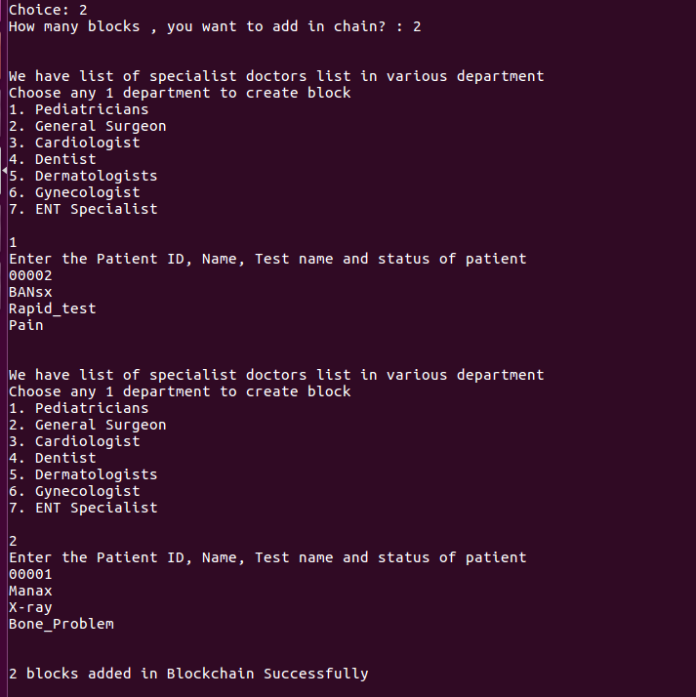
If I take choice 2 :

Slide 17
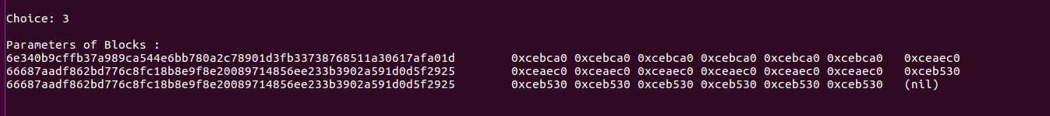
If I take choice 3 :
This is showing hash
Value of the blocks and data .
This data can be transferred
To our client .

Slide 18
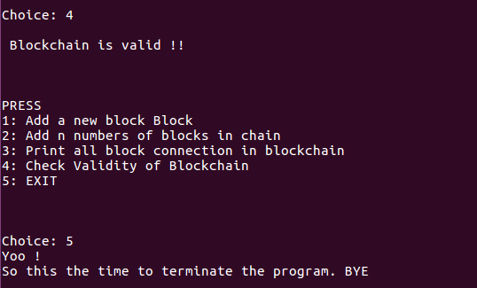
This we are getting
with choice 4
And 5
By this we are
Showing the backend
Process that what is
Actually done in Blockchain

Slide 19
Conclusion & Future Scope
Our blockchain model implementation in C language is successful. In this project implementation of structures,
pointers, linked lists, user define functions, control and jumping statements was initiated. File handling concept
is also applied. We know that since the starting of the era when blockchain technology was launched via bitcoin,
it was evolving into a general purpose technology with use cases in many industries including healthcare. The objective
of the study behind this model was to identify the blockchain technology use cases in healthcare, the example
applications that have been developed for these use cases, the challenges and limitations of the blockchain based
healthcare applications, the current approaches employed in developing these applications and areas for future
research. Since in our model we can create a block, add into the block and check the validity of the block. This will
improve in maintaining access control, scalability and the content or transactions information stays secure. Further
research is also needed to supplement ongoing efforts to address the challenges of better scalability, latency,
interoperability, security and privacy in relation to the use of blockchain technology in healthcare.

Slide 20

THANK YOU
HOPE YOU LIKED THE PROJECT

